Slide 1
CS60050 Machine Learning Linear Regression Part 1
Sudeshna Sarkar Somak Aditya
Department of CSE, IIT Kharagpur
August 9, 2023

Slide 2
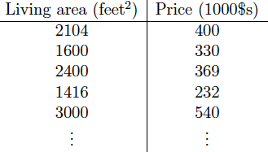
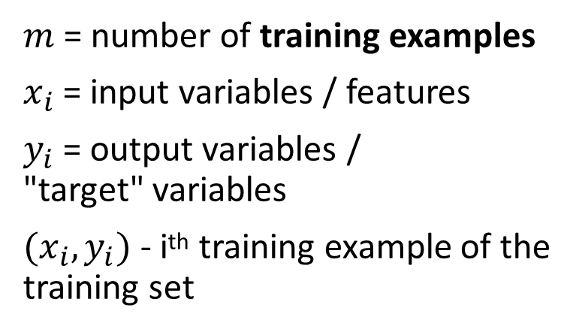
Dataset of living area and price of houses in a city
$m$ = number of training examples
$x_{i}$ = input variables / features
$y_{i}$ = output variables / "target" variables
$(x_{i},y_{i})$ - i^{th} training example of the training set
Training Set
Predict
5000
?
Regression

Slide 3
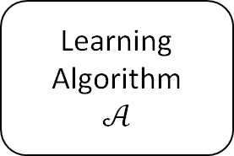
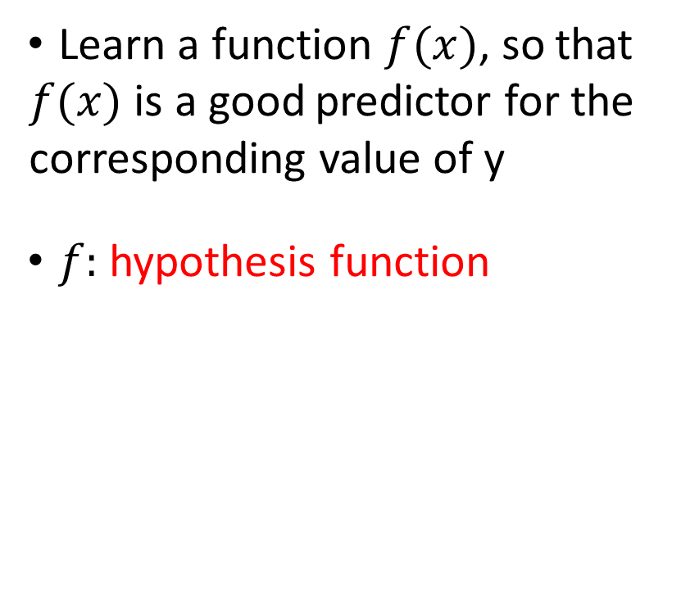
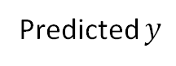
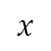
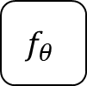
How to use the training set?
Training
Set
Learn a function $f(x)$, so that $f(x)$ is a good predictor for the corresponding value of y
$f:$ hypothesis function
Learning Algorithm
$$𝒜$$
$$x$$
$$f_{θ}$$
Predicted $y$
(living area
Of house)
(Predicted price
Of house)

Slide 4
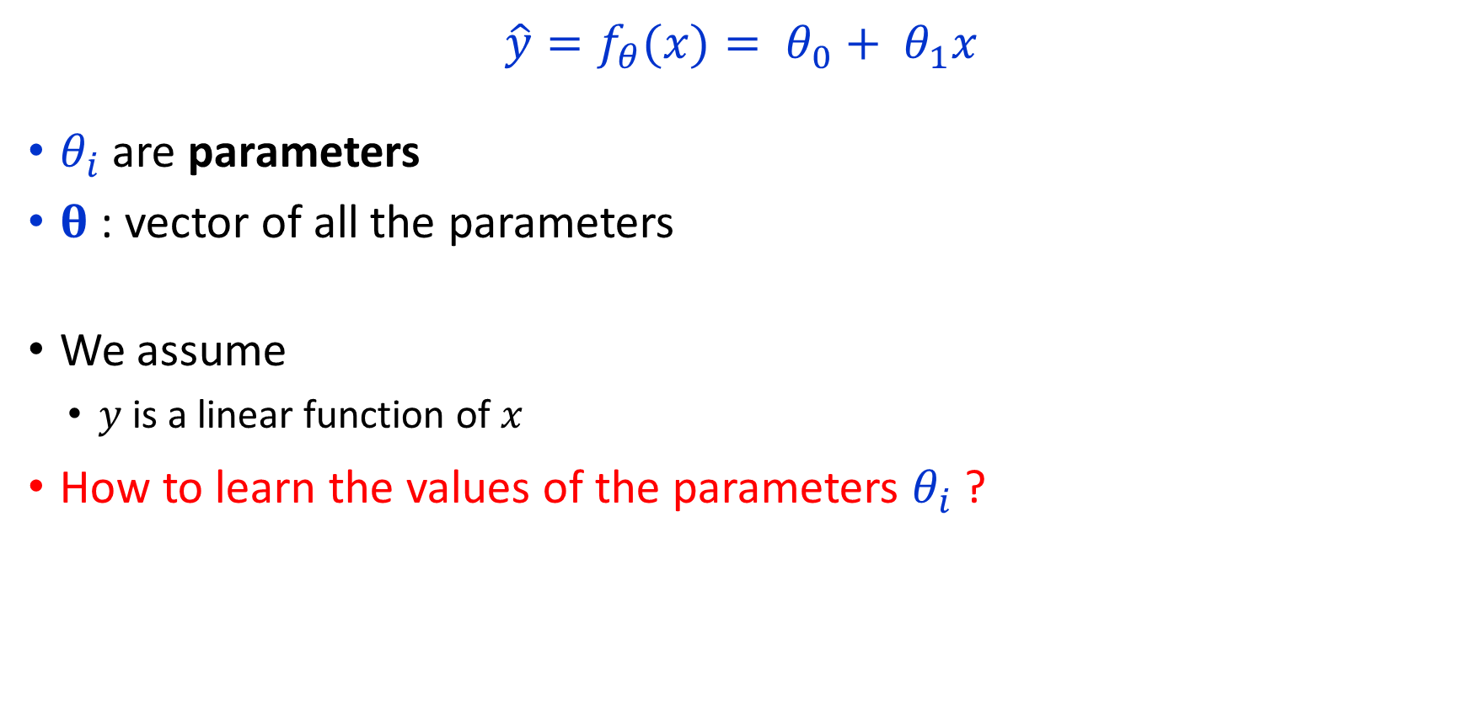
How to represent hypothesis? (linear?)
$$\hat{y}=f_{θ}(x)= θ_{0}+ θ_{1}x$$
$θ_{i}$ are parameters
$θ$: vector of all the parameters
We assume
$y$ is a linear function of $x$
How to learn the values of the parameters $θ_{i}$ ?

Slide 5
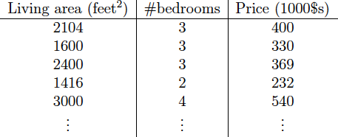
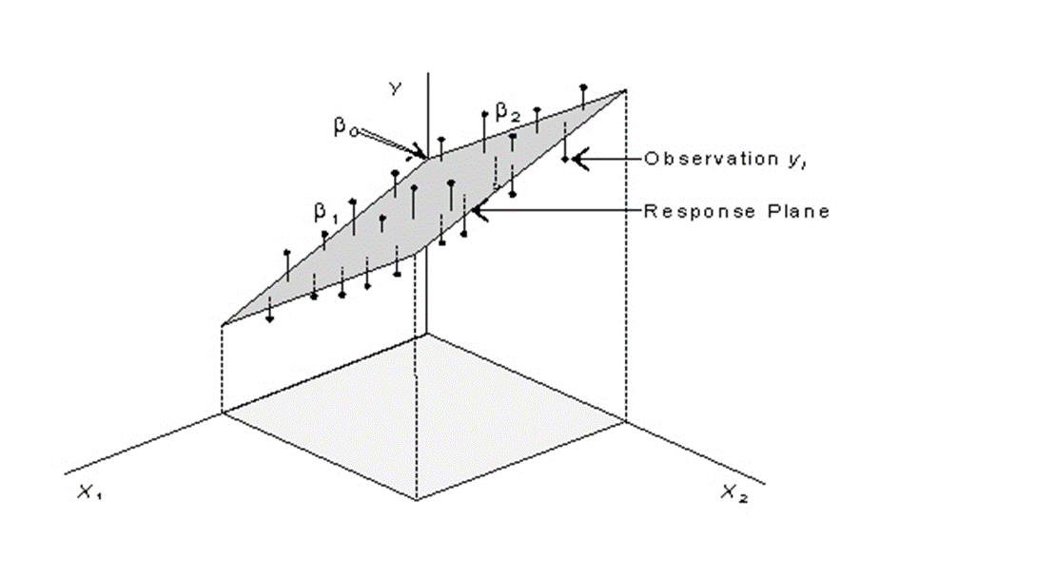
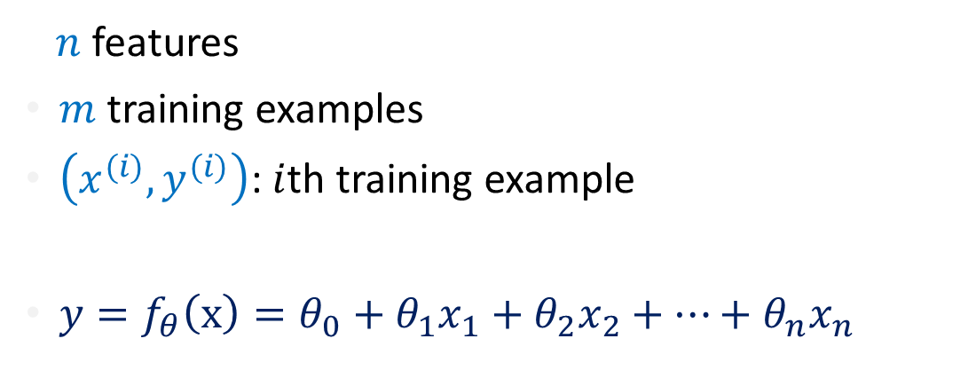
Multivariate Regression
$n$ features
$m$ training examples
$\left(x^{(i)},y^{(i)}\right)$: $i$th training example
$y=f_{θ}\left(x\right)=θ_{0}+θ_{1}x_{1}+θ_{2}x_{2}+…+θ_{n}x_{n}$

Slide 6
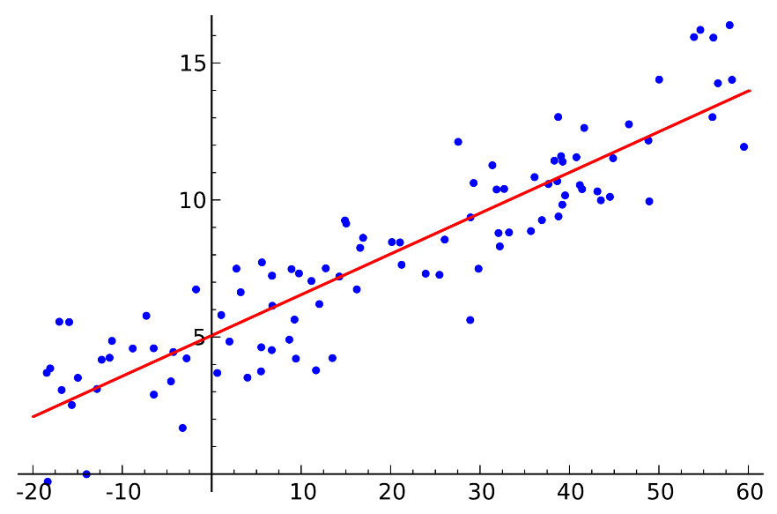
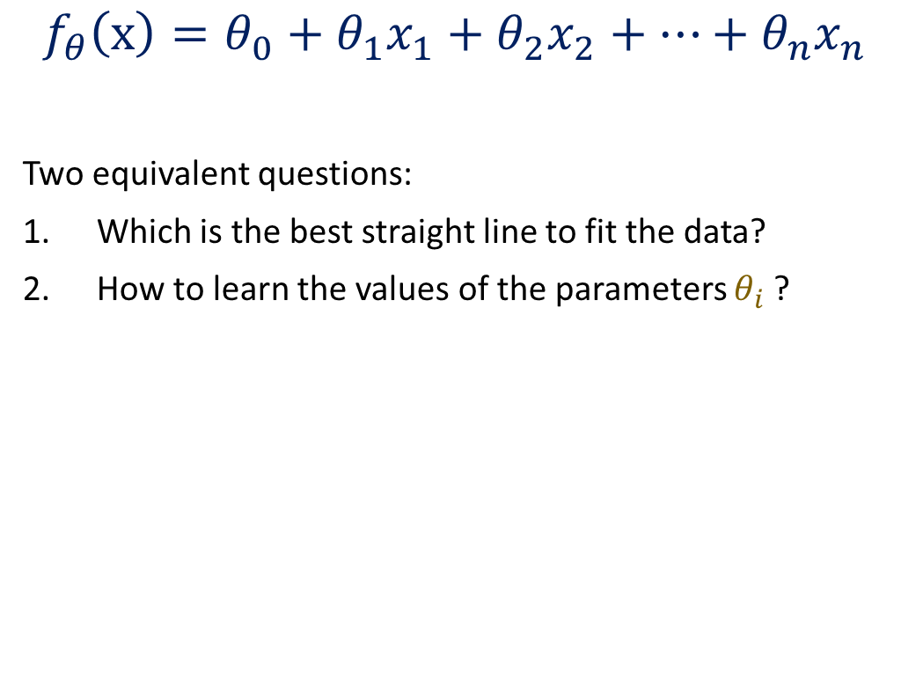
Intuition of hypothesis function
$$f_{θ}\left(x\right)=θ_{0}+θ_{1}x_{1}+θ_{2}x_{2}+…+θ_{n}x_{n}$$
Two equivalent questions:
Which is the best straight line to fit the data?
How to learn the values of the parameters $θ_{i}$ ?

Slide 7
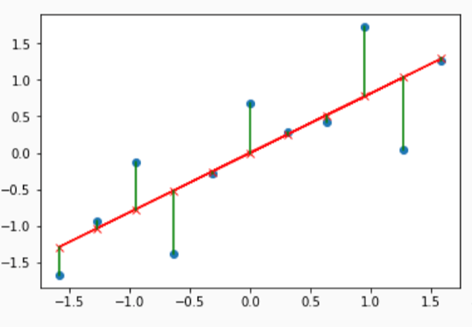
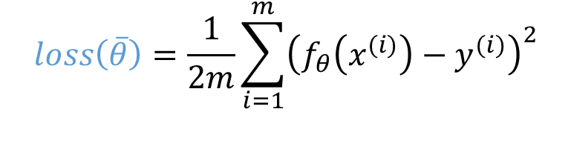
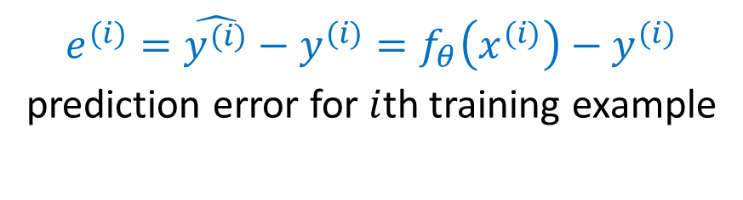
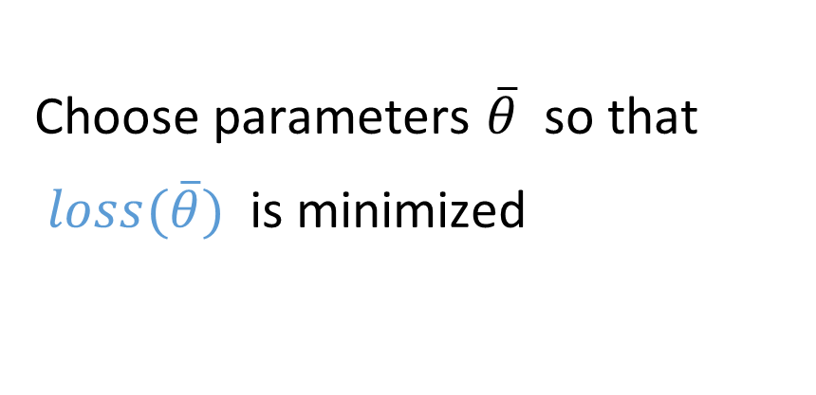
Cost function
$$loss\left(\overline{θ}\right)=\frac{1}{2m}\sum_{i=1}^{m}{{\left(f_{θ}\left(x^{(i)}\right)−y^{(i)}\right)}^{2}}$$
Choose parameters $\overline{θ}$ so that
$loss(\overline{θ})$ is minimized
$$\begin{matrix}minimize \\ \overline{θ}\end{matrix}J\left(\overline{θ}\right)$$
$e^{(i)}=\hat{y^{(i)}}−y^{(i)}=f_{θ}\left(x^{(i)}\right)−y^{(i)}$ prediction error for $i$th training example
Notes:
$$\begin{matrix}minimize \\ \overline{θ}\end{matrix}J\left(\overline{θ}\right)$$

Slide 8
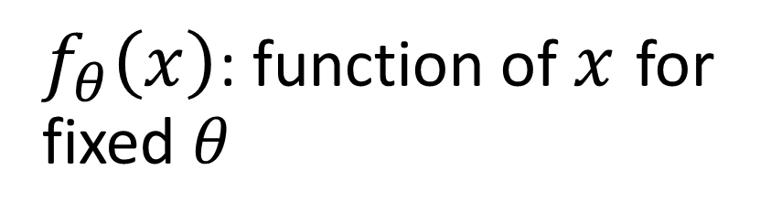
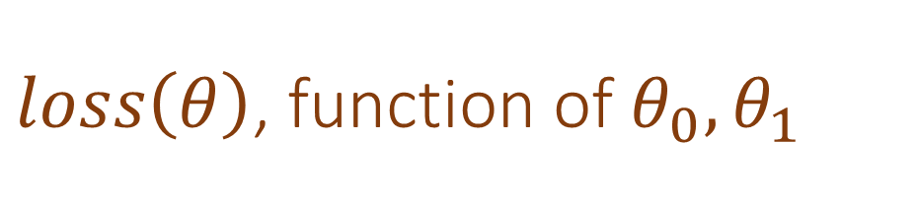
$f_{θ}\left(x\right)$: function of $x$ for fixed $θ$
$loss\left(θ\right)$, function of $θ_{0},θ_{1}$
$$y$$
Fix $θ_{0}$
$$J\left(θ_{1}\right)$$
3
3
2
2
1
1
$$x$$
$$θ_{1}$$
1
2
3
0
1
2
3

Slide 9
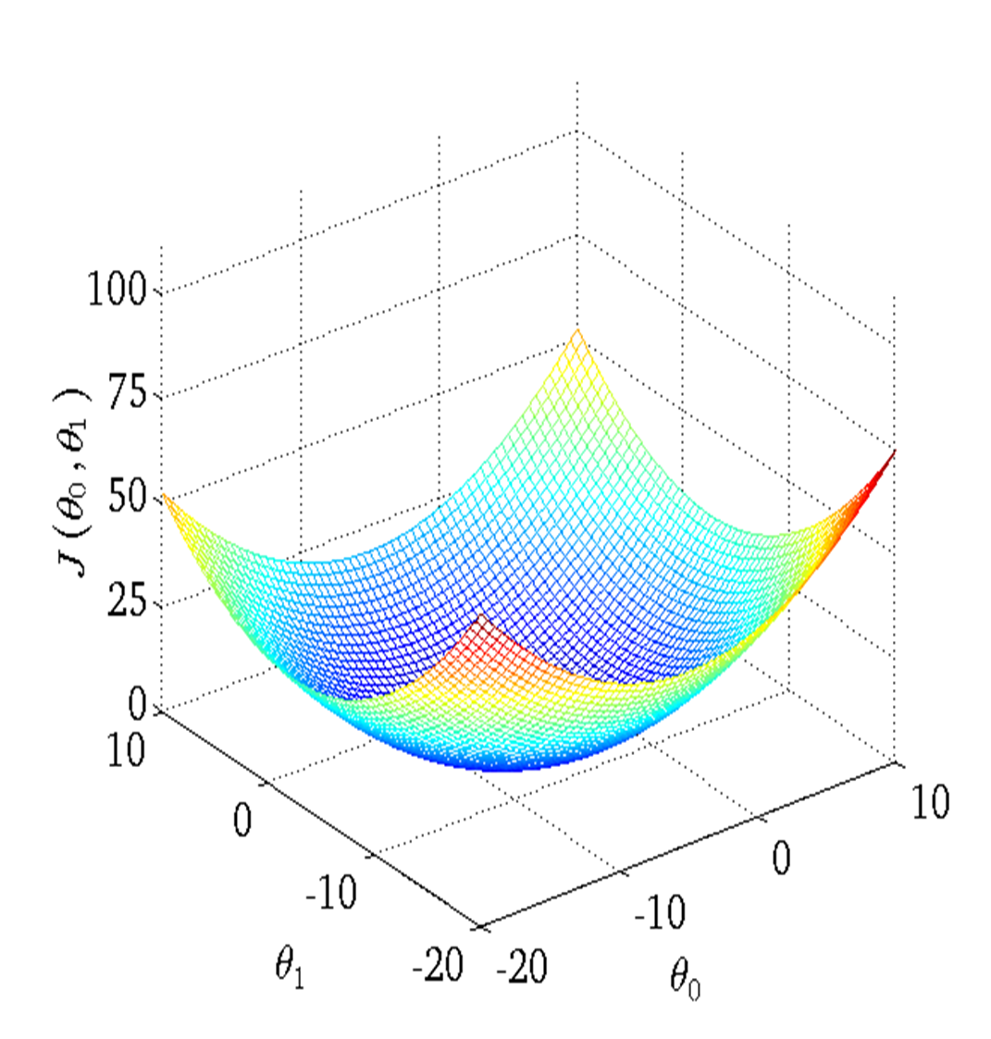
Cost Function
When loss is a function of
both θ₀ and θ₁

Slide 10
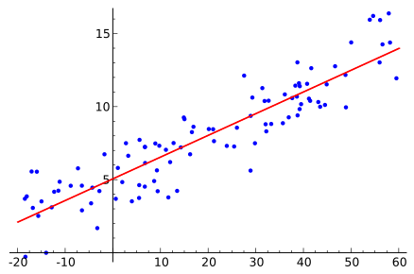

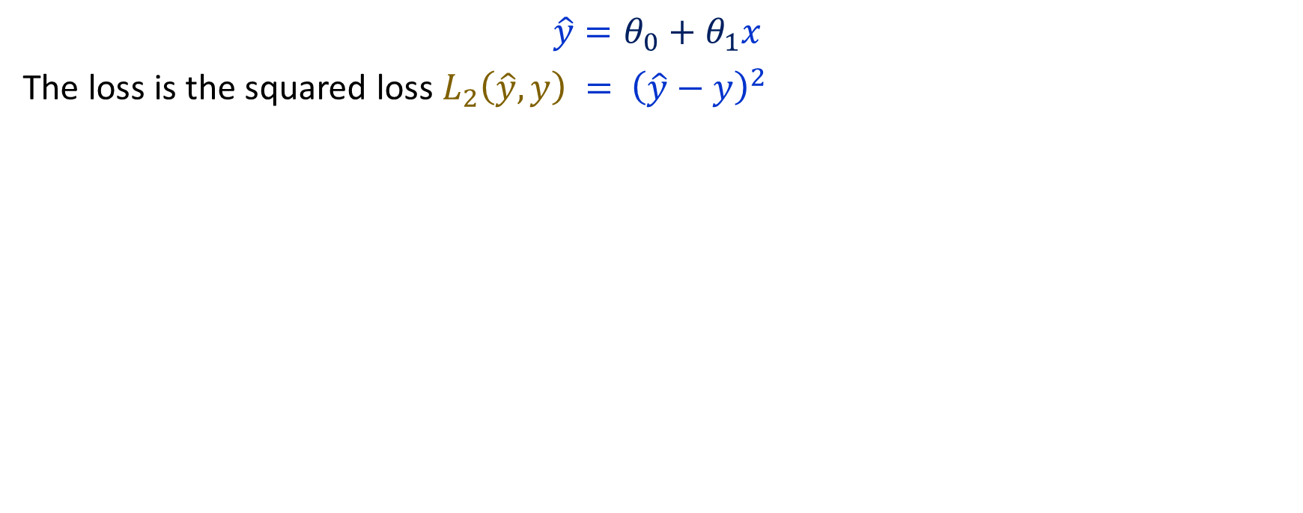
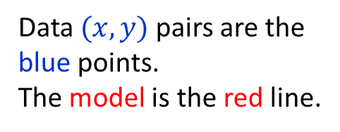
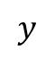
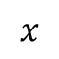

Linear Regression
$$\hat{y}=θ_{0}+θ_{1}x$$
The loss is the squared loss $L_{2}\left(\hat{y},y\right) = {\left(\hat{y}−y\right)}^{2}$
Data $(x,y)$ pairs are the blue points. The model is the red line.
$$y$$
$$y$$
$$\hat{y}$$
$$x$$
Optimization objective: Find model parameters $θ$ that will minimize the loss.

Slide 11
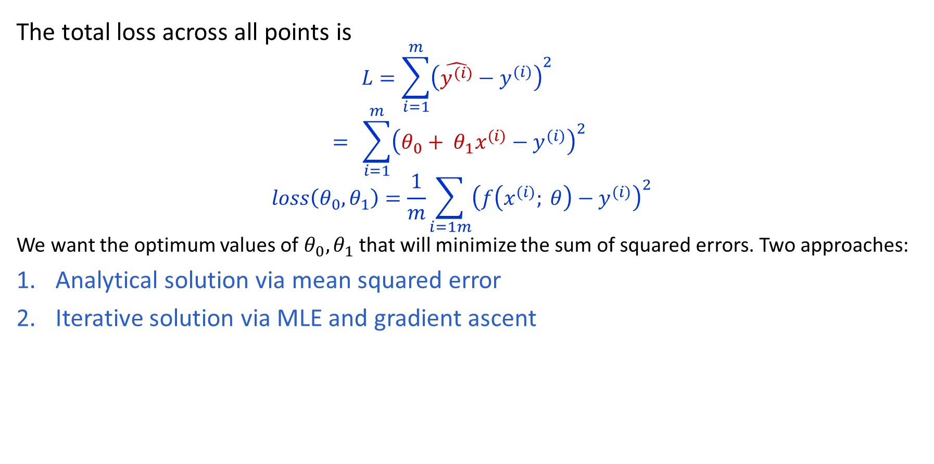
Linear Regression
The total loss across all points is
$$L=\sum_{i=1}^{m}{{\left(\hat{y^{(i)}}−y^{(i)}\right)}^{2}}$$
$$= \sum_{i=1}^{m}{{\left(θ_{0}+ θ_{1}x^{(i)}−y^{(i)}\right)}^{2}}$$
$$loss\left(θ_{0},θ_{1}\right)=\frac{1}{m}\sum_{i=1m}{{\left(f\left(x^{(i)}; θ\right)−y^{(i)}\right)}^{2}}$$
We want the optimum values of $θ_{0},θ_{1}$ that will minimize the sum of squared errors. Two approaches:
Analytical solution via mean squared error
Iterative solution via MLE and gradient ascent

Slide 12
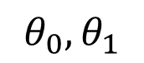
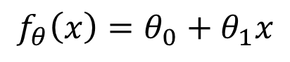
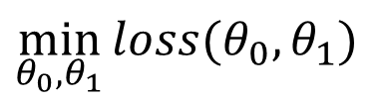
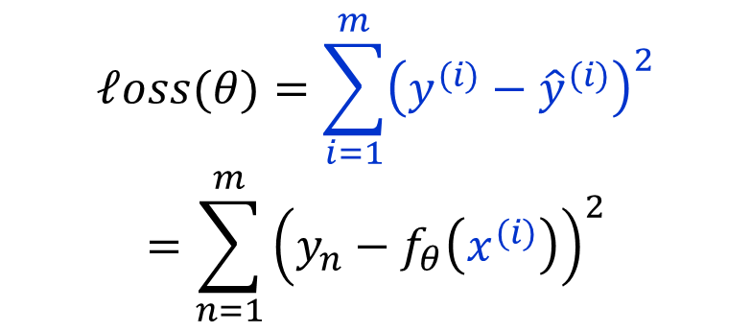
Learning as Optimization Problem
Hypothesis:
Parameters: Cost Function:
Goal:
$$f_{θ}\left(x\right)=θ_{0}+θ_{1}x$$
$$θ_{0},θ_{1}$$
$$ℓoss(θ)=\sum_{i=1}^{m}{{\left(y^{(i)}−{\hat{y}}^{(i)}\right)}^{2}}$$
$$=\sum_{n=1}^{m}{{\left(y_{n}−f_{θ}\left(x^{(i)}\right)\right)}^{2}}$$
$$\min_{θ_{0},θ_{1}}{loss(θ_{0},θ_{1})}$$

Slide 13
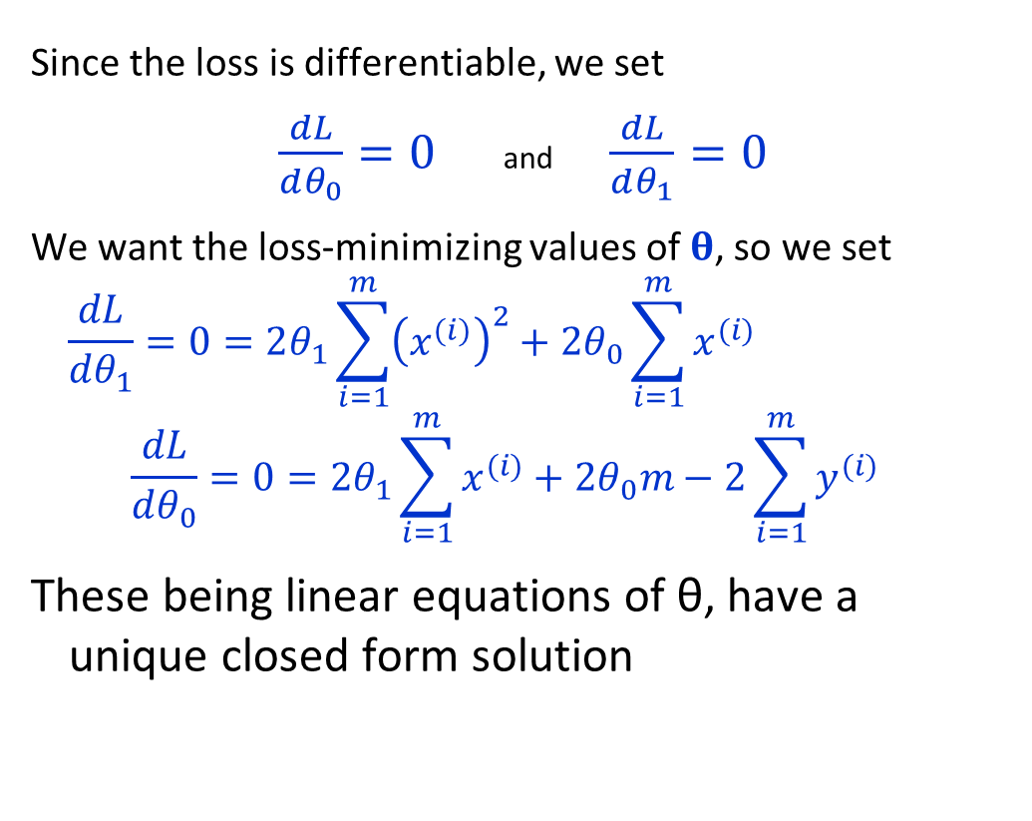
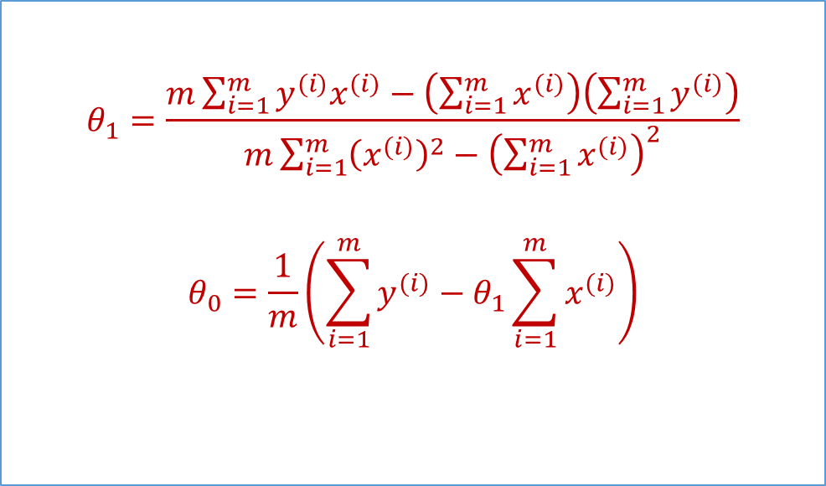

Linear Regression: Analytic Solution
Since the loss is differentiable, we set
$\frac{dL}{dθ_{0}}=0$ and $\frac{dL}{dθ_{1}}=0$
We want the loss-minimizing values of $θ$, so we set
$$\frac{dL}{dθ_{1}}=0=2θ_{1}\sum_{i=1}^{m}{{\left(x^{(i)}\right)}^{2}}+2θ_{0}\sum_{i=1}^{m}{x^{(i)}}−2\sum_{i=1}^{m}{x^{(i)}y^{(i)}}$$
$$\frac{dL}{dθ_{0}}=0=2θ_{1}\sum_{i=1}^{m}{x^{(i)}}+2θ_{0}m−2\sum_{i=1}^{m}{y^{(i)}}$$
These being linear equations of θ, have a unique closed form solution
$$L= \sum_{i=1}^{m}{{\left(θ_{0}+ θ_{1}x^{(i)}−y^{(i)}\right)}^{2}}$$
$$θ_{1}=\frac{m\sum_{i=1}^{m}{y^{(i)}x^{(i)}}−\left(\sum_{i=1}^{m}{x^{(i)}}\right)\left(\sum_{i=1}^{m}{y^{(i)}}\right)}{m\sum_{i=1}^{m}{{\left(x^{(i)}\right)}^{2}}−{\left(\sum_{i=1}^{m}{x^{(i)}}\right)}^{2}}$$
$$θ_{0}=\frac{1}{m}\left(\sum_{i=1}^{m}{y^{(i)}}−θ_{1}\sum_{i=1}^{m}{x^{(i)}}\right)$$
Notes:
Aside: the least-squares loss is convex, making this work.

Slide 14
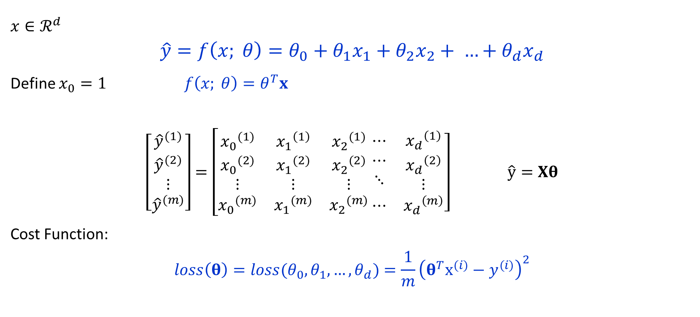
Multivariate Linear Regression
$x∈ℛ^{d}$
$$\hat{y}=f\left(x; θ\right)=θ_{0}+θ_{1}x_{1}+θ_{2}x_{2}+ …+θ_{d}x_{d}$$
Define $x_{0}=1 f\left(x; θ\right)=θ^{T}x$
$\left[\begin{matrix}{\hat{y}}^{(1)} \\ \begin{aligned}{\hat{y}}^{(2)} \\ ⋮\end{aligned} \\ {\hat{y}}^{(m)}\end{matrix}\right]=\left[\begin{matrix}{x_{0}}^{(1)} & {x_{1}}^{\left(1\right)} & {x_{2}}^{(1)} \\ \begin{aligned}{x_{0}}^{(2)} \\ ⋮\end{aligned} & \begin{aligned}{x_{1}}^{(2)} \\ ⋮\end{aligned} & \begin{aligned}{x_{2}}^{(2)} \\ ⋮\end{aligned} \\ {x_{0}}^{(m)} & {x_{1}}^{(m)} & {x_{2}}^{(m)}\end{matrix}\right.$ $\left.\begin{matrix}⋯ & {x_{d}}^{\left(1\right)} \\ \begin{aligned}⋯ \\ ⋱\end{aligned} & \begin{aligned}{x_{d}}^{\left(2\right)} \\ ⋮\end{aligned} \\ ⋯ & {x_{d}}^{\left(m\right)}\end{matrix}\right] \hat{y}=Xθ$
Cost Function:
$$loss\left(θ\right)=loss(θ_{0},θ_{1}, …,θ_{d})=\frac{1}{m}{\left(θ^{T}x^{(i)}−y^{(i)}\right)}^{2}$$

Slide 15
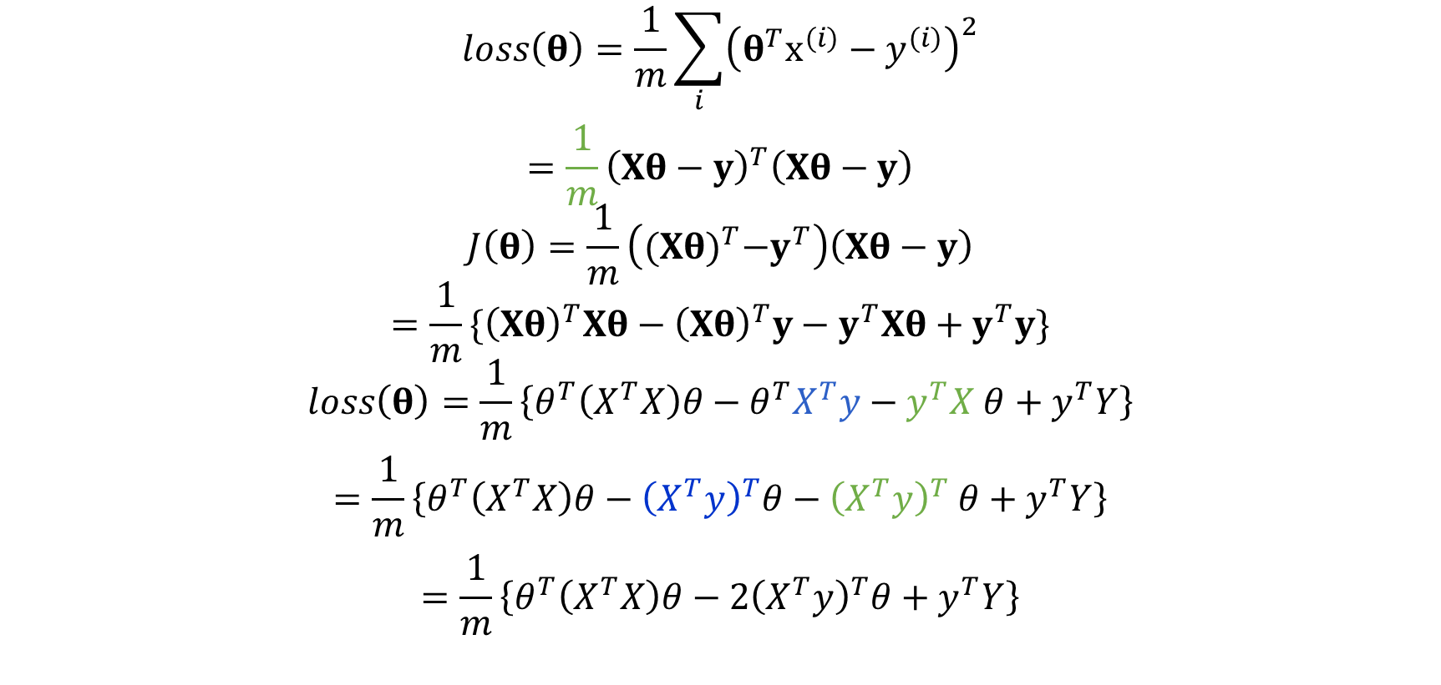
Multivariate Linear Regression
$$loss\left(θ\right)=\frac{1}{m}\sum_{i}{{\left(θ^{T}x^{(i)}−y^{(i)}\right)}^{2}}$$
$$=\frac{1}{m}{\left(Xθ−y\right)}^{T}\left(Xθ−y\right)$$
$$J\left(θ\right)=\frac{1}{m}\left({(Xθ)}^{T}−y^{T}\right)\left(Xθ−y\right)$$
$$=\frac{1}{m}\{{\left(Xθ\right)}^{T}Xθ−{\left(Xθ\right)}^{T}y−y^{T}Xθ+y^{T}y\}$$
$$loss\left(θ\right)=\frac{1}{m}\left\{θ^{T}\left(X^{T}X\right)θ−θ^{T}X^{T}y−y^{T}X θ+y^{T}Y\right\}$$
$$=\frac{1}{m}\left\{θ^{T}\left(X^{T}X\right)θ−{\left(X^{T}y\right)}^{T}θ−{\left(X^{T}y\right)}^{T} θ+y^{T}Y\right\}$$
$$=\frac{1}{m}\left\{θ^{T}\left(X^{T}X\right)θ−{2\left(X^{T}y\right)}^{T}θ+y^{T}Y\right\}$$

Slide 16
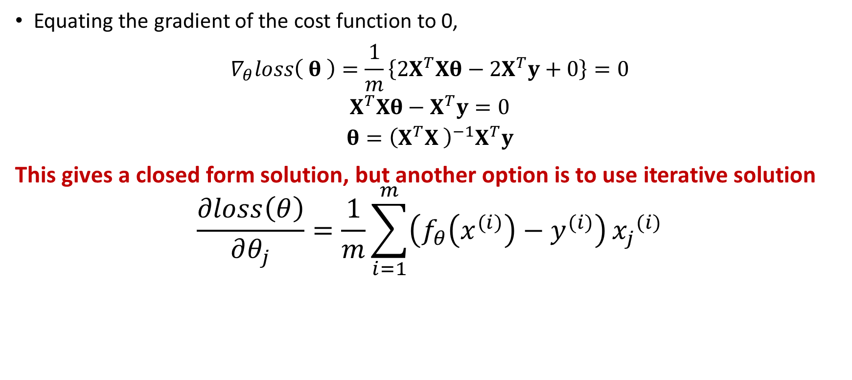
Multivariate Linear Regression
Equating the gradient of the cost function to 0,
$$∇_{θ}loss\left( θ \right)=\frac{1}{m}\left\{2X^{T}Xθ−2X^{T}y+0\right\}=0$$
$$X^{T}Xθ−X^{T}y=0$$
$$θ={\left(X^{T}X \right)}^{−1}X^{T}y$$
This gives a closed form solution, but another option is to use iterative solution
$$\frac{∂loss\left(θ\right)}{∂θ_{j}}=\frac{1}{m}\sum_{i=1}^{m}{\left(f_{θ}\left(x^{(i)}\right)−y^{(i)}\right)}{x_{j}}^{(i)}$$

Slide 17
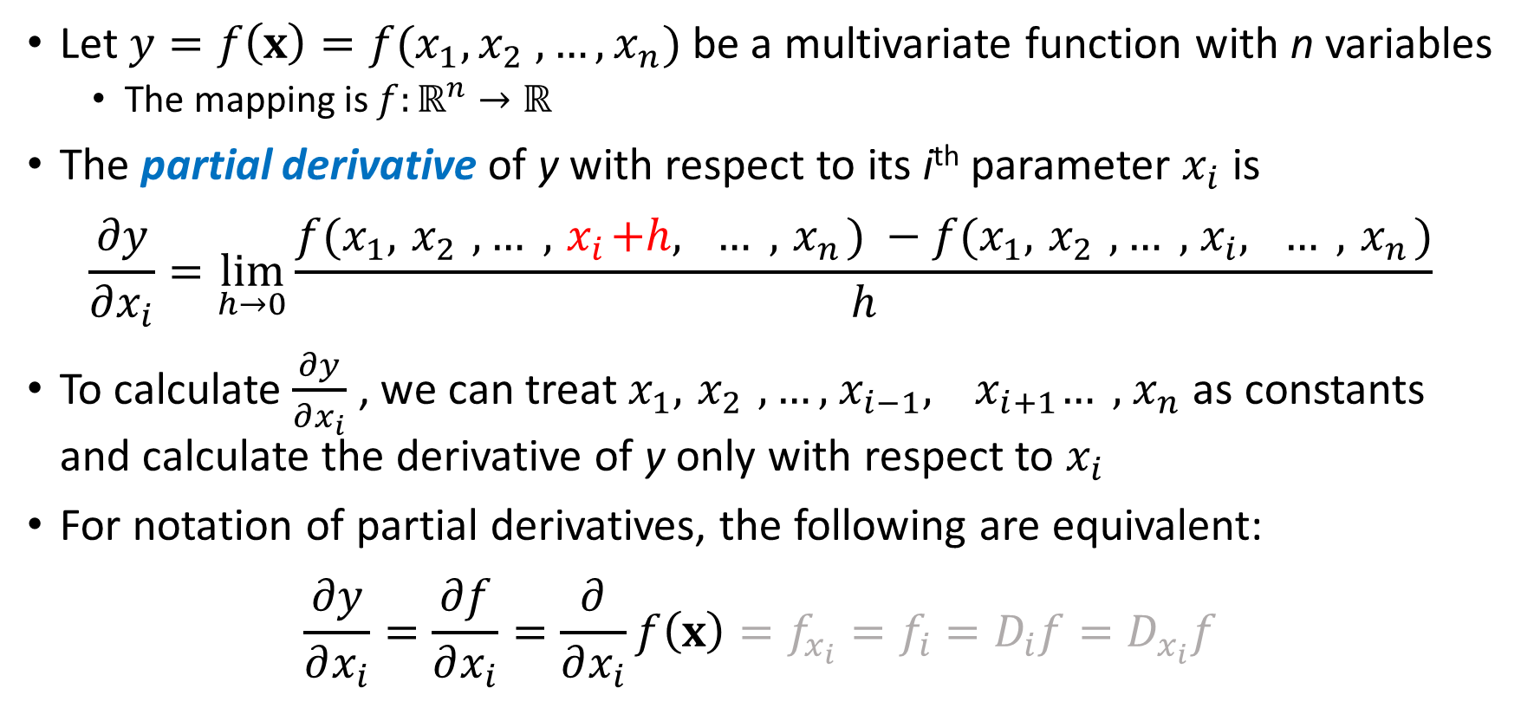
Partial derivatives
Let $y=f\left(x\right)=f(x_{1}, x_{2} ,…,x_{n})$ be a multivariate function with n variables
The mapping is $f:ℝ^{n}→ℝ$
The partial derivative of y with respect to its i^{th} parameter $x_{i}$ is
$$\frac{∂y}{∂x_{i}}=\lim_{h→0}{\frac{f(x_{1}, { x}_{2} ,… ,{ x}_{i}+h, … ,{ x}_{n}) −f(x_{1}, { x}_{2} ,… ,{ x}_{i}, … ,{ x}_{n})}{h}}$$
To calculate $\frac{∂y}{∂x_{i}}$ , we can treat $x_{1}, { x}_{2} ,…,{ x}_{i−1},$ ${ x}_{i+1}… ,{ x}_{n}$as constants and calculate the derivative of y only with respect to $x_{i}$
For notation of partial derivatives, the following are equivalent:
$$\frac{∂y}{∂x_{i}}=\frac{∂f}{∂x_{i}}=\frac{∂}{∂x_{i}}f\left(x\right)=f_{x_{i}}=f_{i}=D_{i}f=D_{x_{i}}f$$

Slide 18
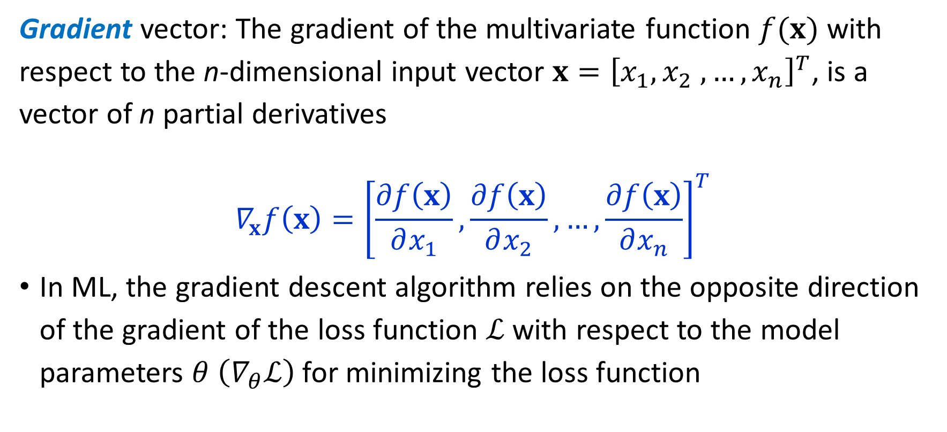
Multidimensional derivative: Gradient
Gradient vector: The gradient of the multivariate function $f(x)$ with respect to the n-dimensional input vector $x={\left[x_{1}, x_{2} ,…,x_{n}\right]}^{T}$, is a vector of n partial derivatives
$$∇_{x}f\left(x\right)={\left[\frac{∂f\left(x\right)}{∂x_{1}},\frac{∂f\left(x\right)}{∂x_{2}},…,\frac{∂f\left(x\right)}{∂x_{n}}\right]}^{T}$$
In ML, the gradient descent algorithm relies on the opposite direction of the gradient of the loss function $ℒ$ with respect to the model parameters $θ$ $\left(∇_{θ}ℒ\right)$for minimizing the loss function

Slide 19
Minimizing cost function & Gradient Descent

Slide 20

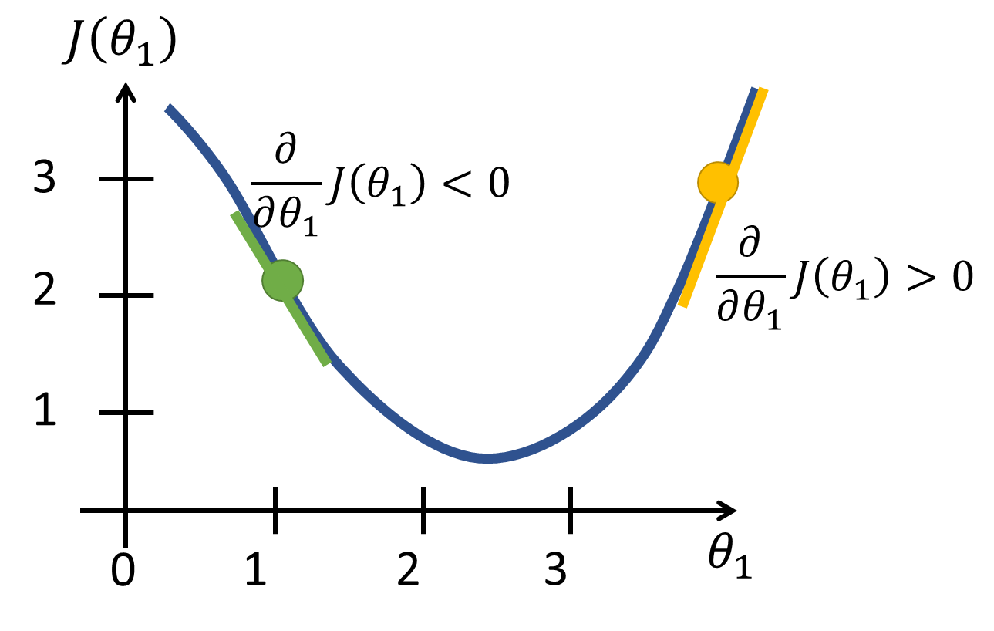
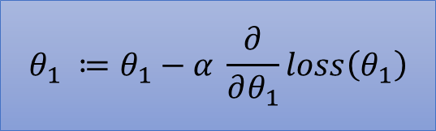
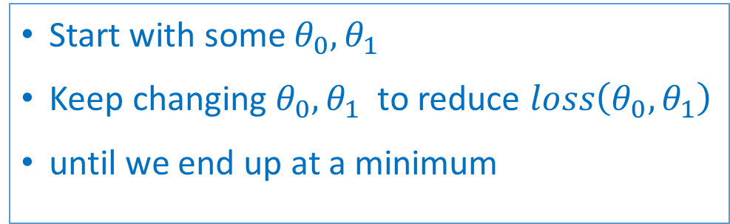

Minimizing function $loss\left(θ_{0},θ_{1}\right)$
Start with some $θ_{0},θ_{1}$
Keep changing $θ_{0},θ_{1}$ to reduce $loss\left(θ_{0}, θ_{1}\right)$
until we end up at a minimum
$$θ_{1} ≔θ_{1}−α \frac{∂}{∂θ_{1}}loss\left(θ_{1}\right)$$
Notes:
Consider some arbitrary function
Analytical minimization not scalable to complex functions of hundreds of parameters
Gradient Descent algorithm
Efficient and scalable to thousands of parameters
Used in many applications of minimizing functions
If the derivative is positive, reduce value of θ₁
If the derivative is negative, increase value of θ₁

Slide 21
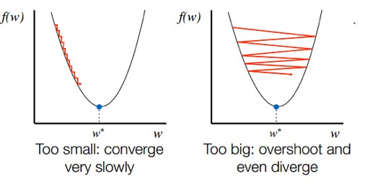
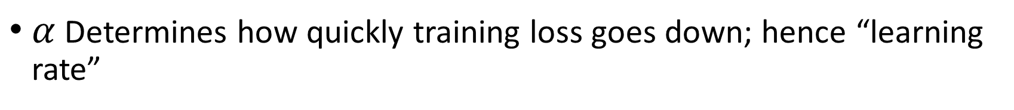

Step Size $α$
$α$ Determines how quickly training loss goes down; hence “learning rate”

Slide 22
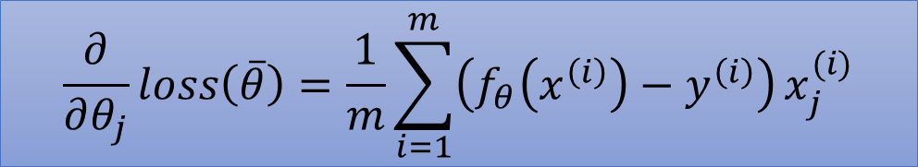
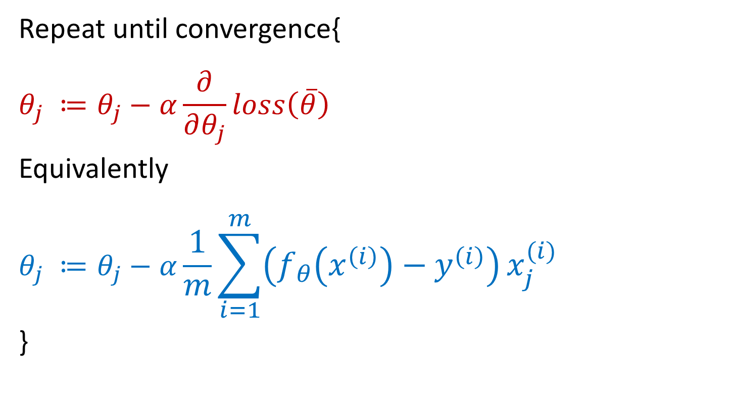
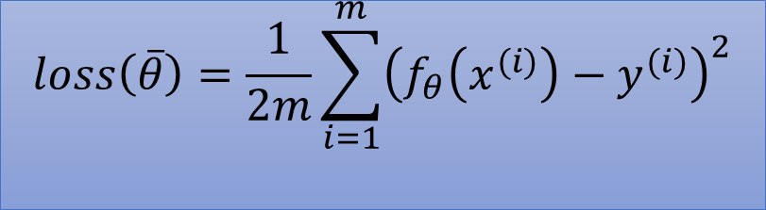
Computing partial derivatives
$$loss\left(\overline{θ}\right)=\frac{1}{2m}\sum_{i=1}^{m}{{\left(f_{θ}\left(x^{(i)}\right)−y^{(i)}\right)}^{2}}$$
Repeat until convergence{
$$θ_{j} ≔θ_{j}−α\frac{∂}{∂θ_{j}}loss\left(\overline{θ}\right)$$
Equivalently
$$θ_{j} ≔θ_{j}−α\frac{1}{m}\sum_{i=1}^{m}{\left(f_{θ}\left(x^{\left(i\right)}\right)−y^{\left(i\right)}\right)}x_{j}^{(i)}$$
}
$$\frac{∂}{∂θ_{j}}loss\left(\overline{θ}\right)=\frac{1}{m}\sum_{i=1}^{m}{\left(f_{θ}\left(x^{\left(i\right)}\right)−y^{\left(i\right)}\right)}x_{j}^{(i)}$$

Slide 23
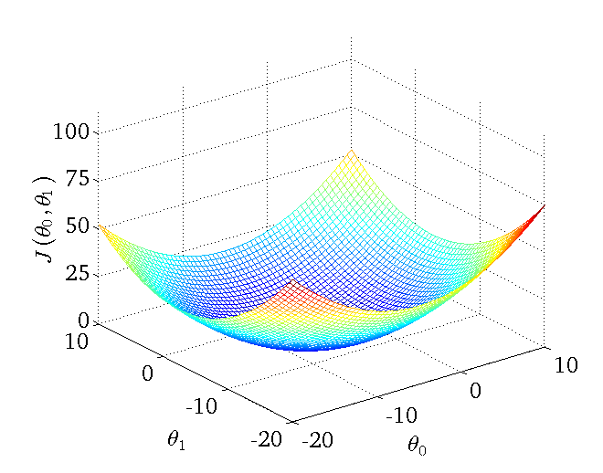
Convergence
The cost function in linear regression is always a convex function – always has a single global minimum
So, gradient descent will always converge

Slide 24
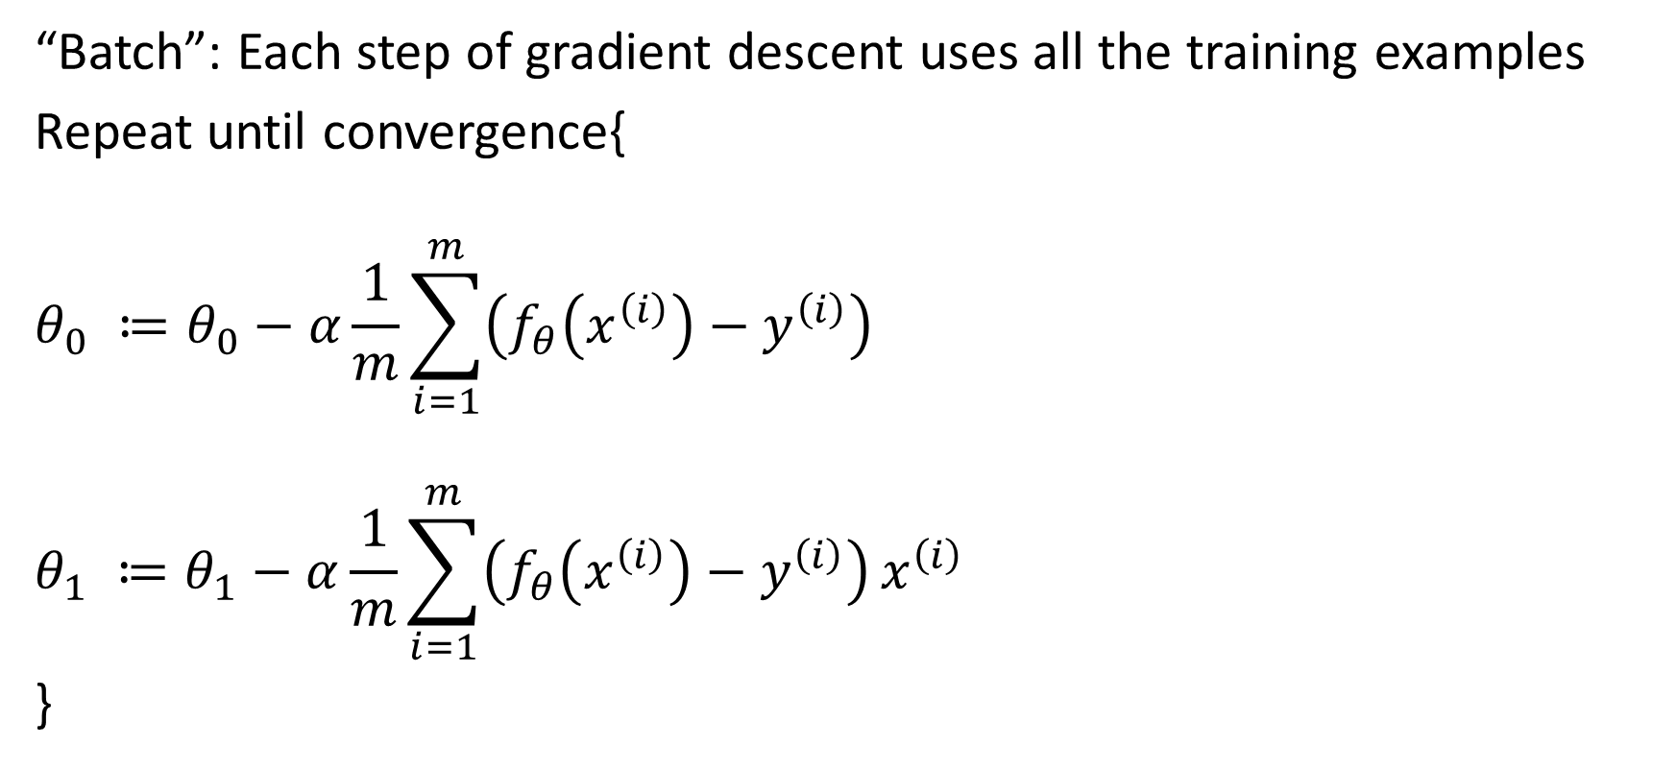
Batch gradient descent
“Batch”: Each step of gradient descent uses all the training examples
Repeat until convergence{
$$θ_{0} ≔θ_{0}−α\frac{1}{m}\sum_{i=1}^{m}{\left(f_{θ}\left(x^{\left(i\right)}\right)−y^{\left(i\right)}\right)}$$
$$θ_{1} ≔θ_{1}−α\frac{1}{m}\sum_{i=1}^{m}{\left(f_{θ}\left(x^{\left(i\right)}\right)−y^{\left(i\right)}\right)}x^{\left(i\right)}$$
}
$m$: Number of training examples

